Slide 1

Daily and Total vaccination for covid-19 in the world.
- Mrinal K Patil
© All rights reserved by Fireblaze Technologies Pvt. Ltd.

Slide 2
Task:-
1. Which country is using what vaccine?
2. Where are vaccinated more people per day? But in terms of a percent from the entire population?
3. Track the progress of COVID - 19 vaccination.
© All rights reserved by Fireblaze Technologies Pvt. Ltd.

Slide 3
About the Data set:
1. Country- this is the country for which the vaccination information is provided;
2. Country ISO Code - ISO code for the country.
3. Date - date for the data entry; for some of the dates we have only the daily vaccinations, for others, only the (cumulative) total.
4. Total number of vaccinations - this is the absolute number of total immunizations in the country.
5. Total number of people vaccinated - a person, depending on the immunization scheme, will receive one or more (typically 2) vaccines; at a certain moment, the number of vaccination might be larger than the number of people.
6. Total number of people fully vaccinated - this is the number of people that received the entire set of immunization according to the immunization scheme (typically 2); at a certain moment in time, there might be a certain number of people that received one vaccine and another number (smaller) of people that received all vaccines in the scheme.
7. Daily vaccinations (raw) - for a certain data entry, the number of vaccination for that date/country.
© All rights reserved by Fireblaze Technologies Pvt. Ltd.

Slide 4
Conti…
8. Daily vaccinations - for a certain data entry, the number of vaccination for that date/country.
9. Total vaccinations per hundred - ratio (in percent) between vaccination number and total population up to the date in the country.
10. Total number of people vaccinated per hundred - ratio (in percent) between population immunized and total population up to the date in the country.
11. Total number of people fully vaccinated per hundred - ratio (in percent) between population fully immunized and total population up to the date in the country.
12. Number of vaccinations per day - number of daily vaccination for that day and country.
13. Daily vaccinations per million - ratio (in ppm) between vaccination number and total population for the current date in the country.
14. Vaccines used in the country - total number of vaccines used in the country (upto date).
15. Source name - source of the information (national authority, international organization, local organization, etc.).
16. Source website - website of the source of information.
© All rights reserved by Fireblaze Technologies Pvt. Ltd.

Slide 5
Missing values in our data set:
total_vaccinations - 2950
people_vaccinated - 3471
people_fully_vaccinated - 4843
daily_vaccinations_raw - 3709
daily_vaccinations - 187
total_vaccinations_per_hundred - 2950
people_vaccinated_per_hundred - 3471
people_fully_vaccinated_per_hundred - 4843
daily_vaccinations_per_million - 187
© All rights reserved by Fireblaze Technologies Pvt. Ltd.

Slide 6
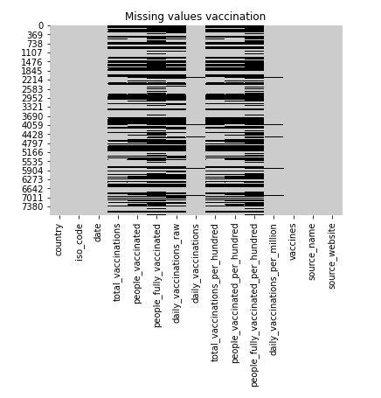
Plotting missing values of vaccination using a heat map
© All rights reserved by Fireblaze Technologies Pvt. Ltd.

Slide 7
Treating missing values:
As we can see there are many missing values (i.e null values) in our data set, we need to treat this data before proceeding for further analysis.
These missing values can be treated in two ways Replacing the null values
Dropping the null values
In this data set I have dropped the null values.
© All rights reserved by Fireblaze Technologies Pvt. Ltd.

Slide 8
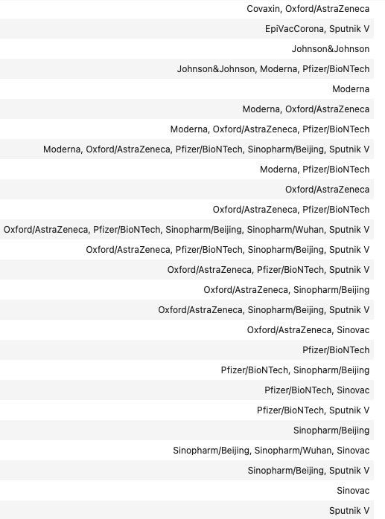
The vaccines used till date are:
© All rights reserved by Fireblaze Technologies Pvt. Ltd.

Slide 9
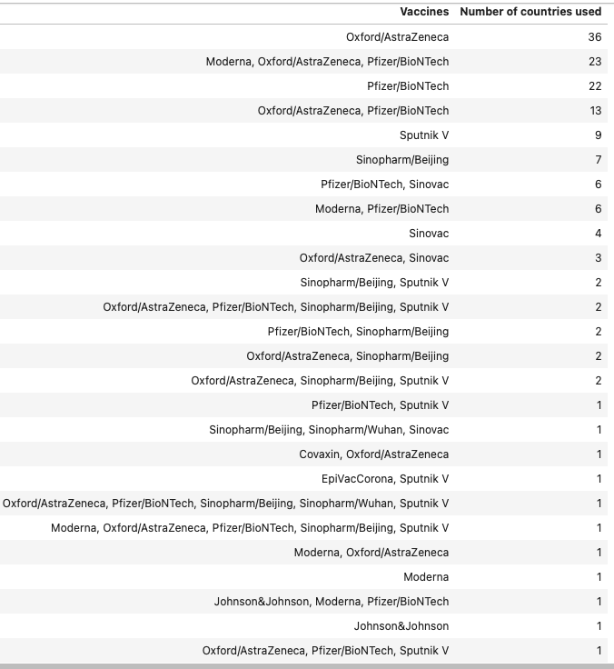
The vaccine count :
© All rights reserved by Fireblaze Technologies Pvt. Ltd.

Slide 10
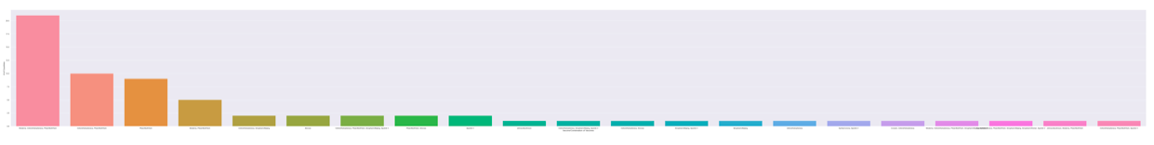
Vaccine or combination of vaccines being used the most in the world currently:
From the fig we can clearly see that Oxford/AstraZeneca is currently being used by most of the countries in the world. Pfizer/BioNTech & the combination of Moderna, Oxford/AstraZeneca & Pfizer/BioNTech are the second-most used vaccine in the world.
© All rights reserved by Fireblaze Technologies Pvt. Ltd.

Slide 11
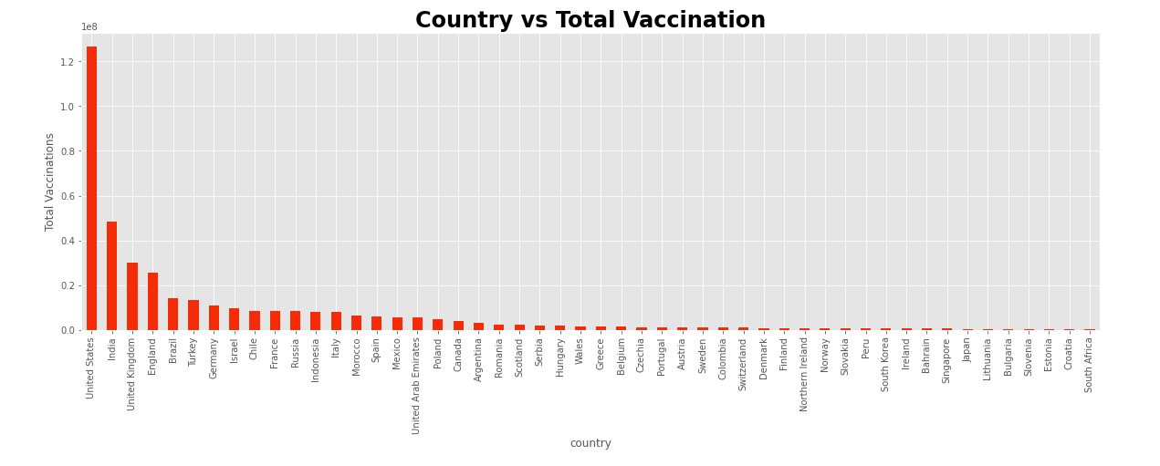
Plotting bar graph for Total vaccination w.r.t to country:
From the graph we can clearly see that the number of total vaccination is highest in USA followed by India and UK .
© All rights reserved by Fireblaze Technologies Pvt. Ltd.

Slide 12
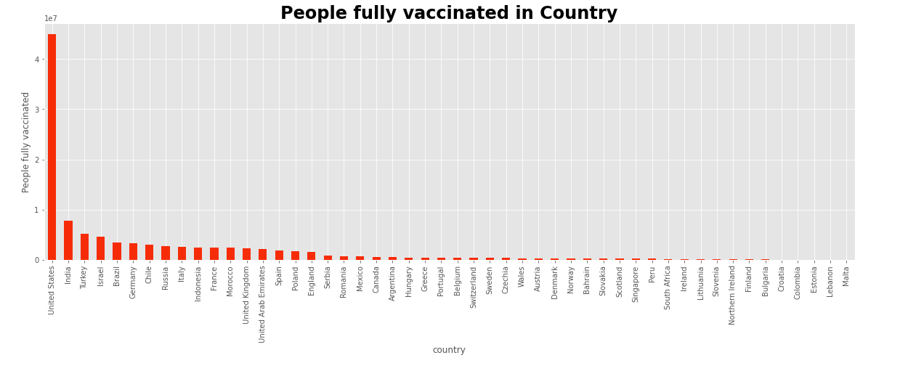
Plotting bar graph for people fully vaccinated w.r.t to country:
From the graph we can clearly see that the number of people fully vaccinated is highest in USA followed by India and Turkey
© All rights reserved by Fireblaze Technologies Pvt. Ltd.

Slide 13
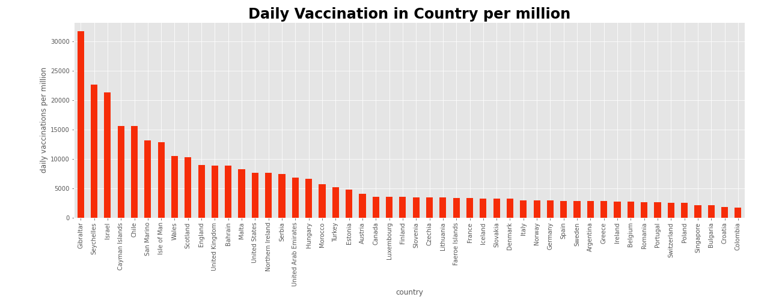
Plotting bar graph for Daily Vaccination per million w.r.t to country :
From the graph we can clearly see that the number of Daily Vaccination per million is highest in Gibraltar followed by Seychelles and Israel.
© All rights reserved by Fireblaze Technologies Pvt. Ltd.

Slide 14
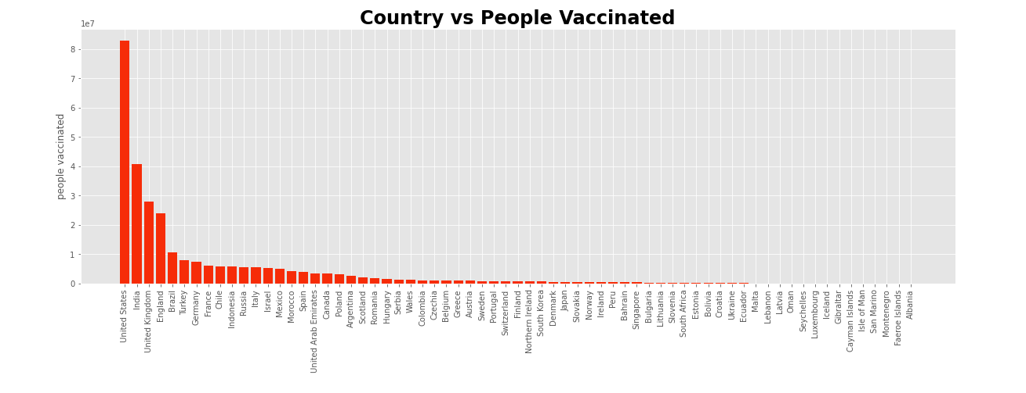
Plotting bar graph for People Vaccinated w.r.t to country :
From the graph we can clearly see that the number of People Vaccinated in highest is USA followed by India and UK.
© All rights reserved by Fireblaze Technologies Pvt. Ltd.

Slide 15
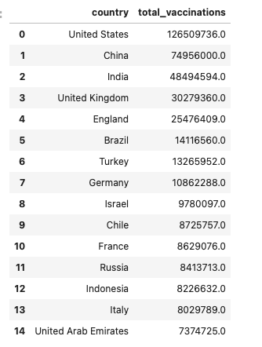
The countries which has vaccinated more people are :
The total number of vaccinations is highest in United States with the count of 126509736
© All rights reserved by Fireblaze Technologies Pvt. Ltd.

Slide 16
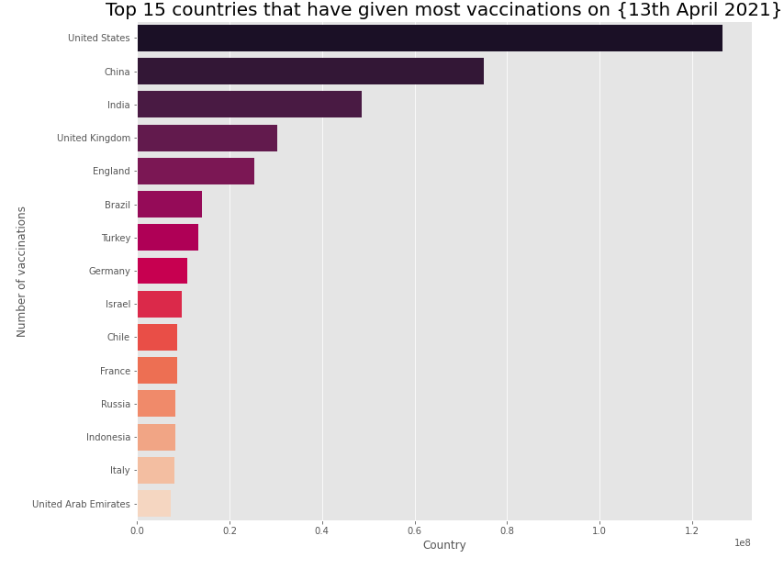
Top 15 countries that have given most vaccinations till 13th April 2021
© All rights reserved by Fireblaze Technologies Pvt. Ltd.

Slide 17
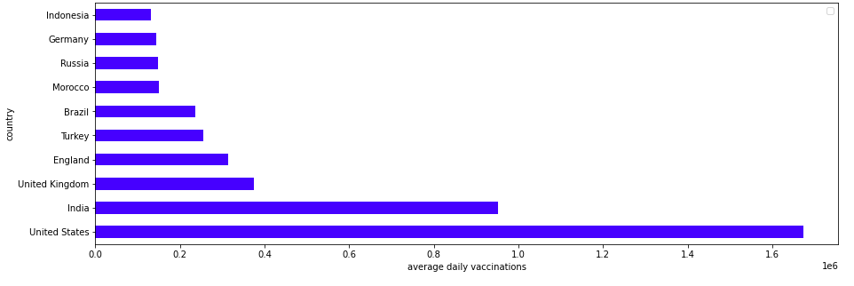
Average daily vaccinations by country - Top 10
The count of vaccinations per day is highest in United States followed by India and UK.
© All rights reserved by Fireblaze Technologies Pvt. Ltd.

Slide 18
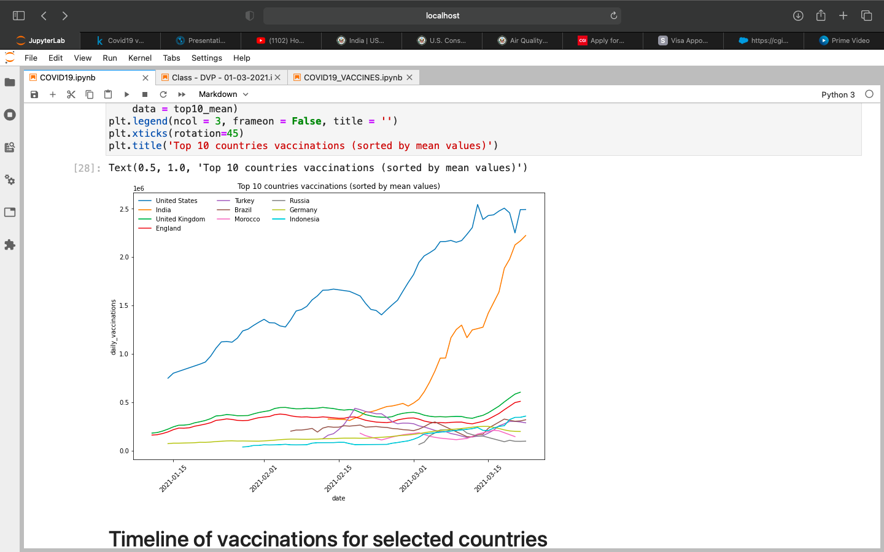
Top 10 countries vaccinations sorted by mean values:
© All rights reserved by Fireblaze Technologies Pvt. Ltd.

Slide 19
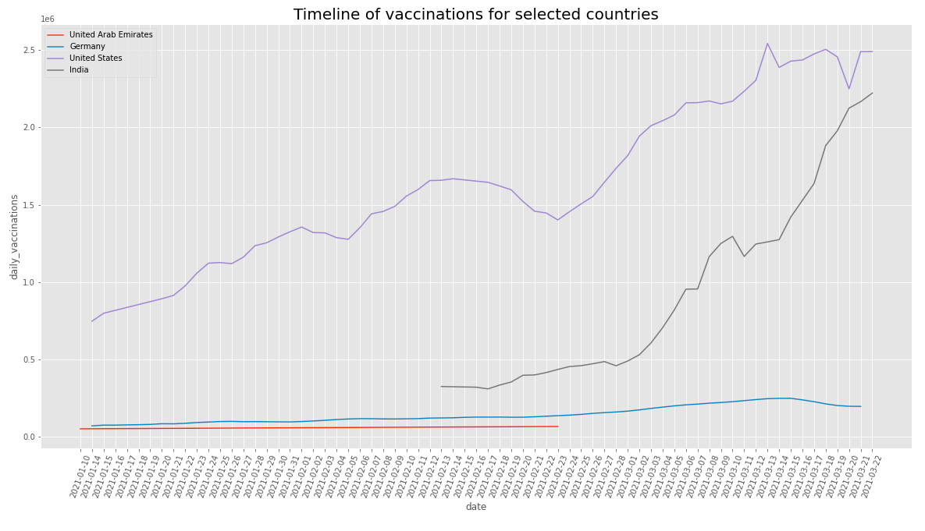
Timeline for vaccination for countries:
UAE
Germany
USA
India
© All rights reserved by Fireblaze Technologies Pvt. Ltd.

Slide 20
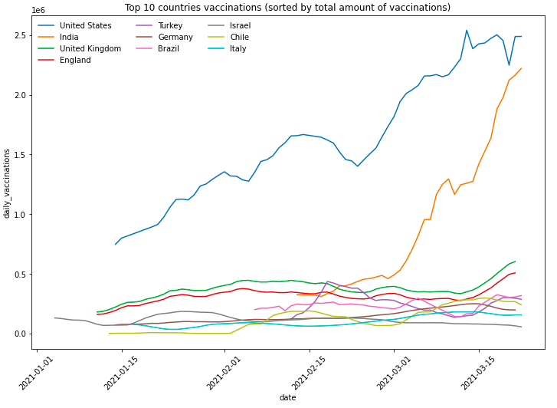
Top 10 countries vaccinations sorted by total amount of vaccinations :
© All rights reserved by Fireblaze Technologies Pvt. Ltd.

Slide 21
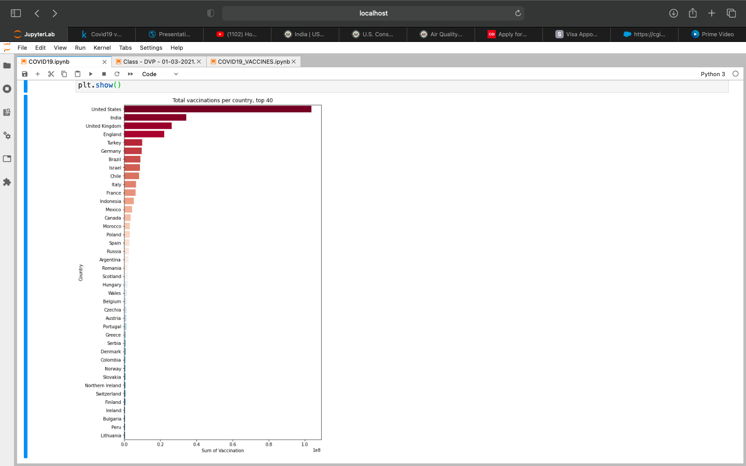
Total Vaccinations per Country :
© All rights reserved by Fireblaze Technologies Pvt. Ltd.

Slide 22
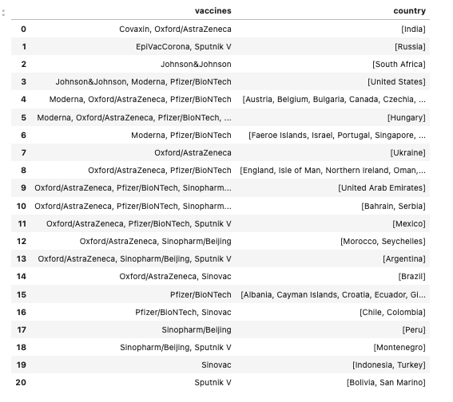
The name of vaccine used by the countries are:
© All rights reserved by Fireblaze Technologies Pvt. Ltd.

Slide 23
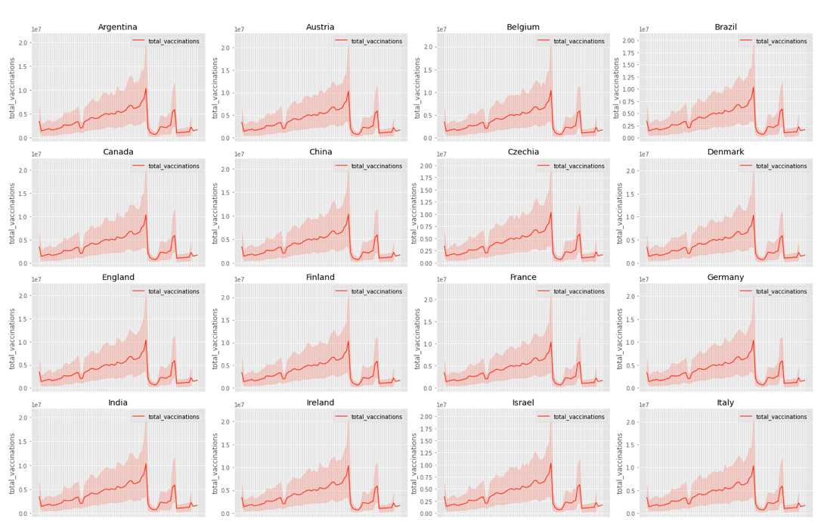
Trend of Total Vaccination :
© All rights reserved by Fireblaze Technologies Pvt. Ltd.

Slide 24
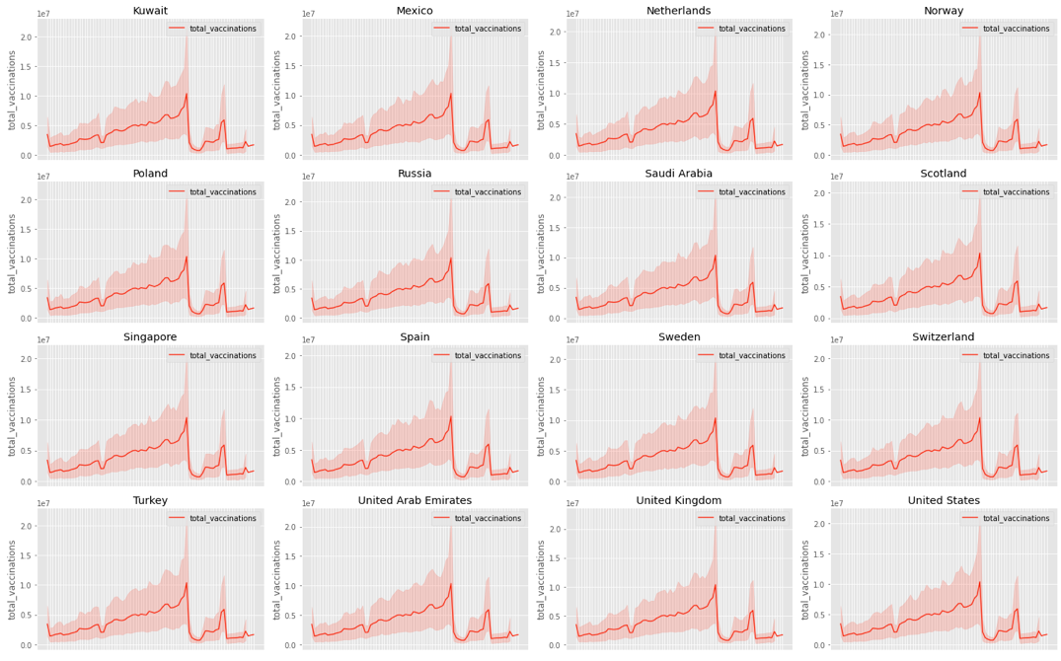
Trend of Total Vaccination (Conti…) :
© All rights reserved by Fireblaze Technologies Pvt. Ltd.

Slide 25
“ Analysis for Vaccination in INDIA ”
© All rights reserved by Fireblaze Technologies Pvt. Ltd.

Slide 26
Important summary of the data :
Name of Vaccine used - Covaxin, Oxford/AstraZeneca
People Vaccinated - 40631153.0
People fully vaccinated - 7863441.0
Total Vaccinations – 48494594.0
Daily Vaccinations - 2221023.0
© All rights reserved by Fireblaze Technologies Pvt. Ltd.

Slide 27
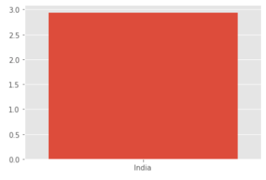
Maximum percentage of people vaccinated in India :
From the graph we can clearly see that the maximum percentage of people vaccinated in India is only approx 3% .
© All rights reserved by Fireblaze Technologies Pvt. Ltd.

Slide 28
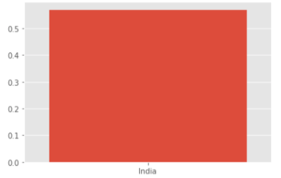
Maximum percentage of people fully vaccinated in India :
From the graph we can clearly see that the maximum percentage of people vaccinated in india is only approx 1% .
© All rights reserved by Fireblaze Technologies Pvt. Ltd.

Slide 29
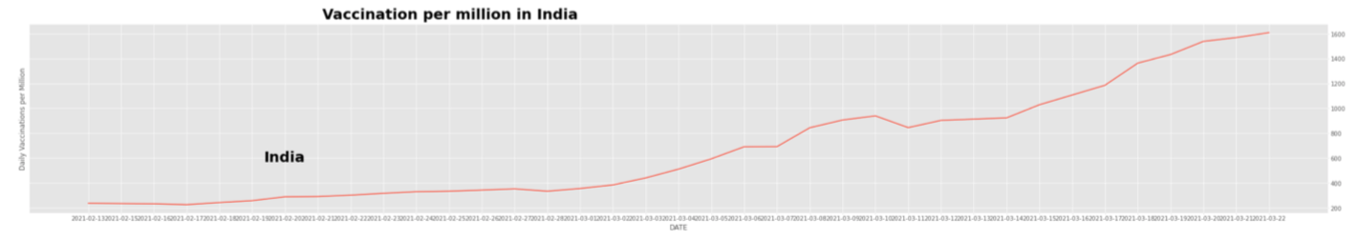
Trend of vaccinations per million in India w.r.t date :
© All rights reserved by Fireblaze Technologies Pvt. Ltd.

Slide 30
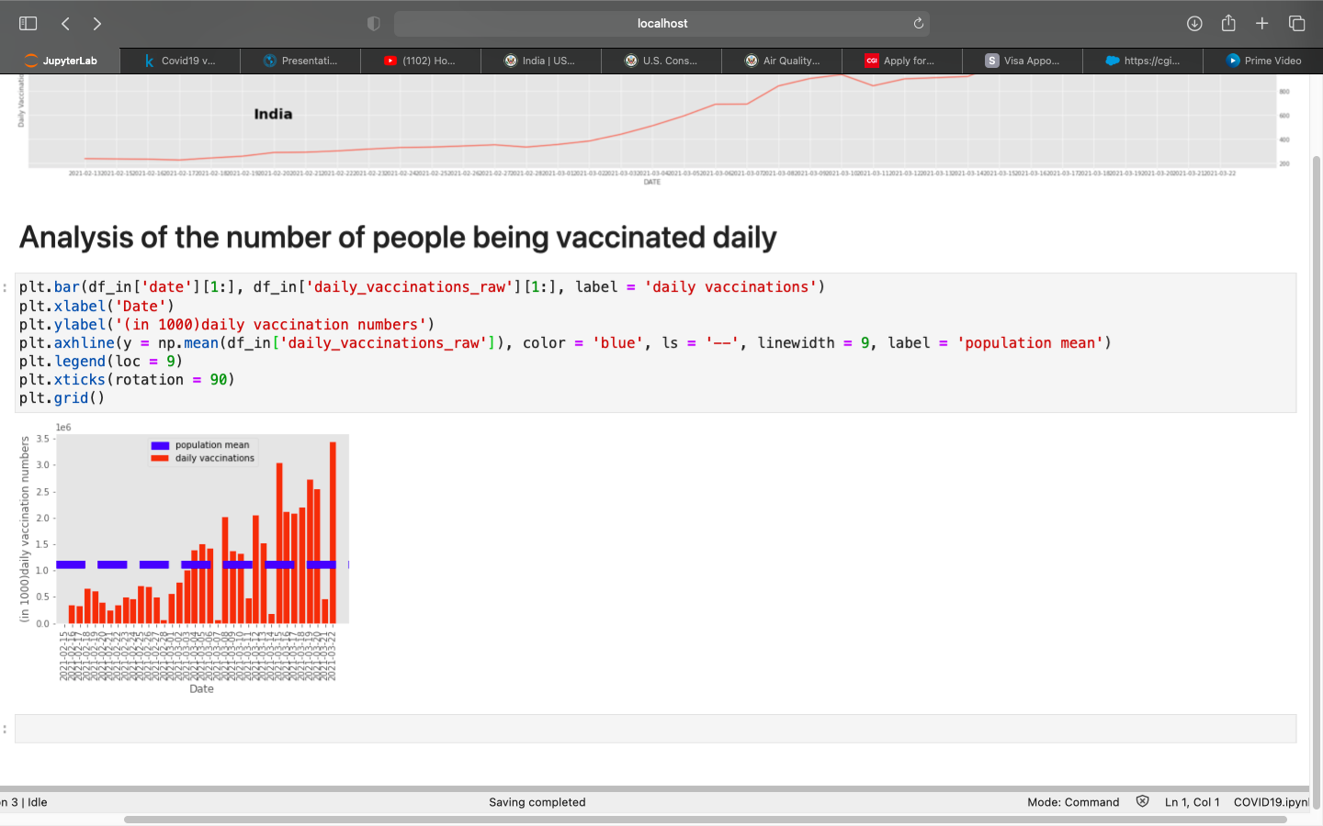
Analysis for number of people vaccinated on daily basis:
© All rights reserved by Fireblaze Technologies Pvt. Ltd.

Slide 31
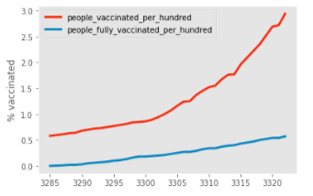
Trend for people vaccinated per hundred and people fully vaccinated per hundred :
© All rights reserved by Fireblaze Technologies Pvt. Ltd.

Slide 32
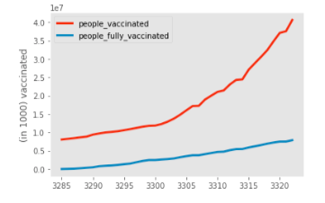
Trend for people vaccinated and people fully vaccinated :
© All rights reserved by Fireblaze Technologies Pvt. Ltd.

Slide 33
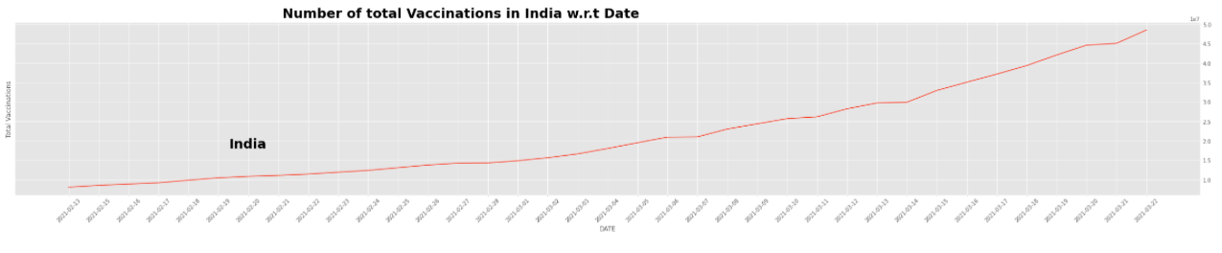
Trend for number of total Vaccinations w.r.t date :
© All rights reserved by Fireblaze Technologies Pvt. Ltd.

Slide 34
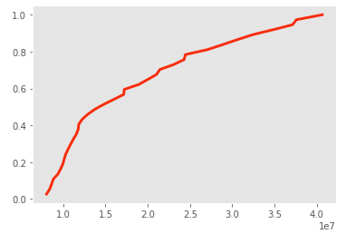
Analytical distribution of number of people vaccinated :
The number of people being vaccinated has been increasing exponentially (the graph demonstrates an exponential distribution).
© All rights reserved by Fireblaze Technologies Pvt. Ltd.

Slide 35
Pfizer/BioNTech
© All rights reserved by Fireblaze Technologies Pvt. Ltd.

Slide 36
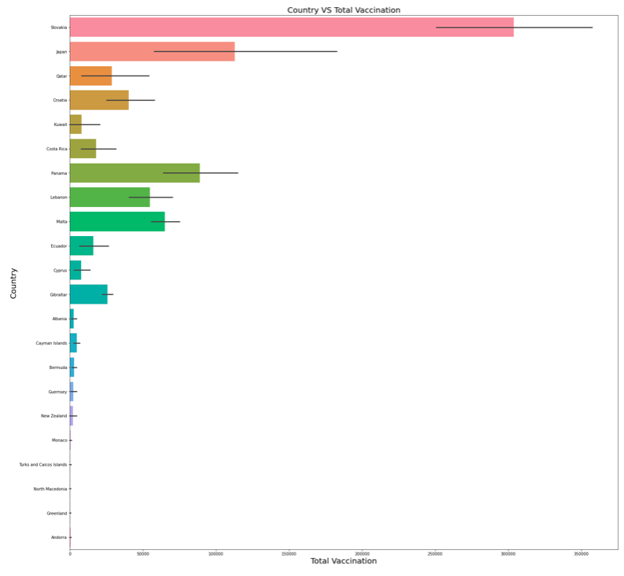
Total Vaccination vs country :
© All rights reserved by Fireblaze Technologies Pvt. Ltd.

Slide 37
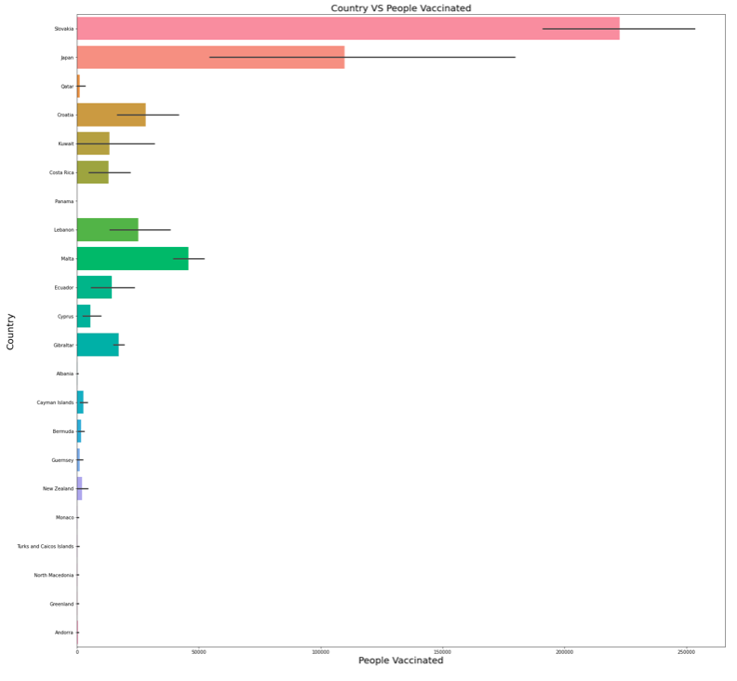
Country vs People vaccinated :
© All rights reserved by Fireblaze Technologies Pvt. Ltd.

Slide 38
Sputnik V
© All rights reserved by Fireblaze Technologies Pvt. Ltd.

Slide 39
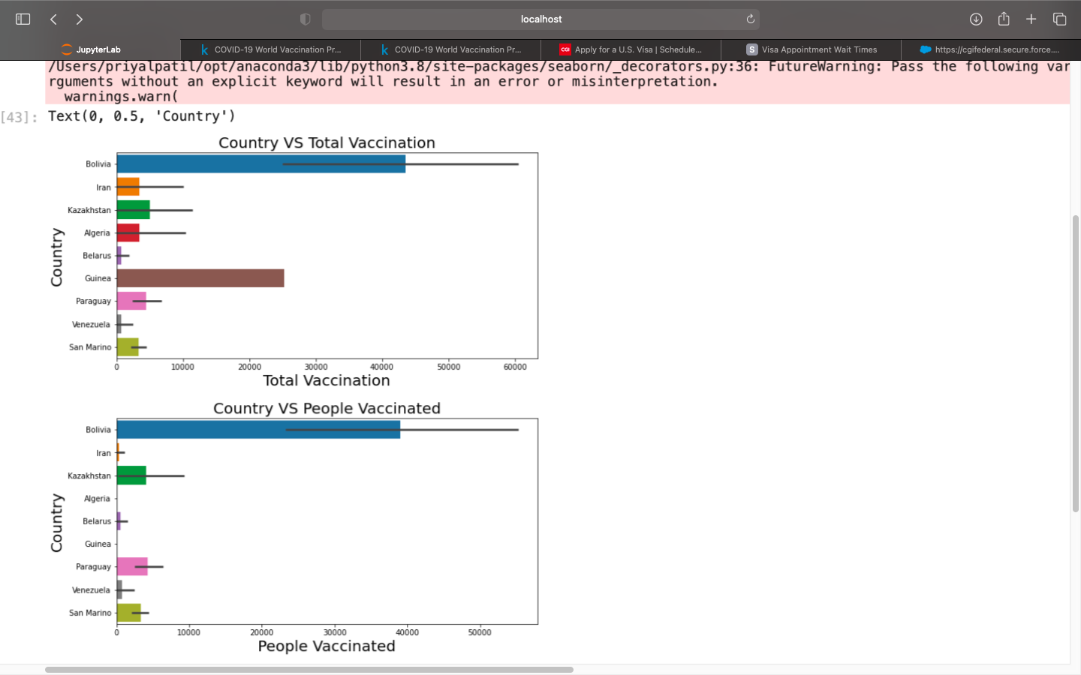
Total Vaccination vs country :
© All rights reserved by Fireblaze Technologies Pvt. Ltd.

Slide 40
Country vs People vaccinated :
© All rights reserved by Fireblaze Technologies Pvt. Ltd.

Slide 41
Oxford/AstraZeneca
© All rights reserved by Fireblaze Technologies Pvt. Ltd.

Slide 42
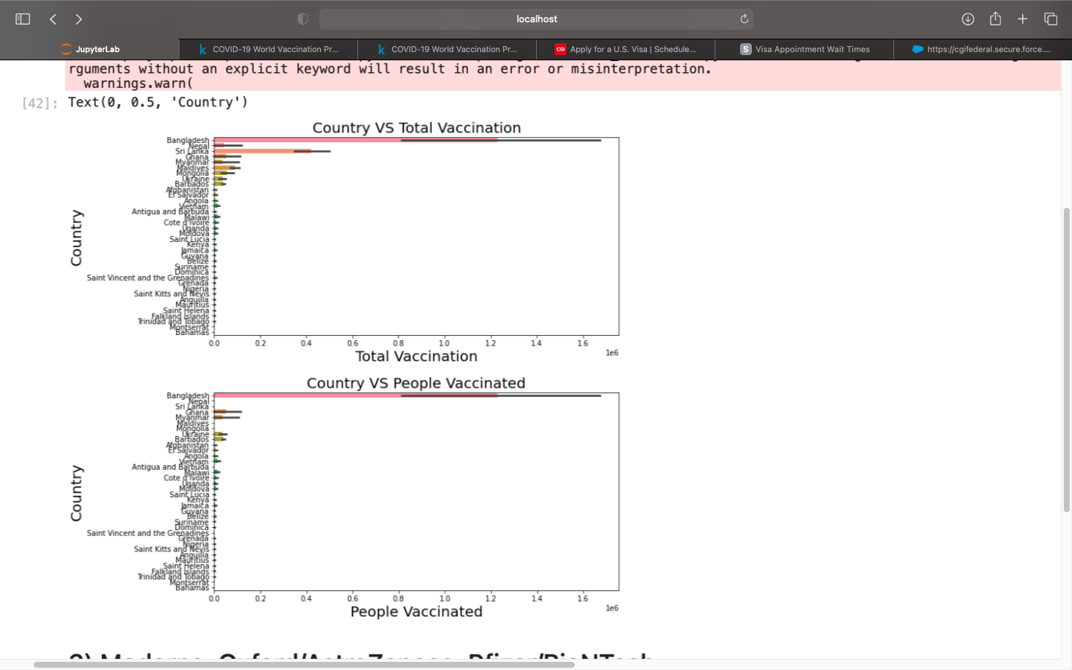
Country vs Total Vaccination :
© All rights reserved by Fireblaze Technologies Pvt. Ltd.

Slide 43
Country vs People vaccinated :
© All rights reserved by Fireblaze Technologies Pvt. Ltd.

Slide 44
Moderna, Oxford/AstraZeneca, Pfizer/BioNTech¶
© All rights reserved by Fireblaze Technologies Pvt. Ltd.

Slide 45
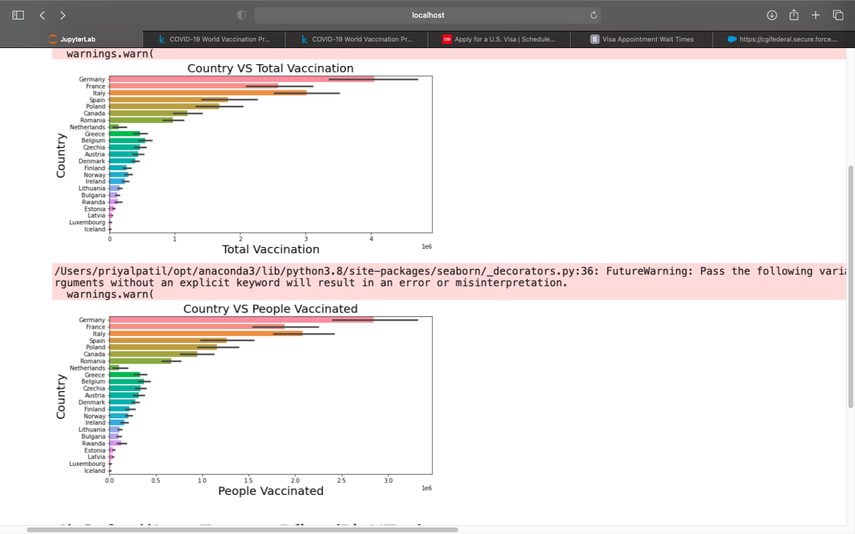
Country vs Total Vaccination :
© All rights reserved by Fireblaze Technologies Pvt. Ltd.

Slide 46
Country vs People vaccinated :
© All rights reserved by Fireblaze Technologies Pvt. Ltd.

Slide 47
Oxford/AstraZeneca, Pfizer/BioNTech
© All rights reserved by Fireblaze Technologies Pvt. Ltd.

Slide 48
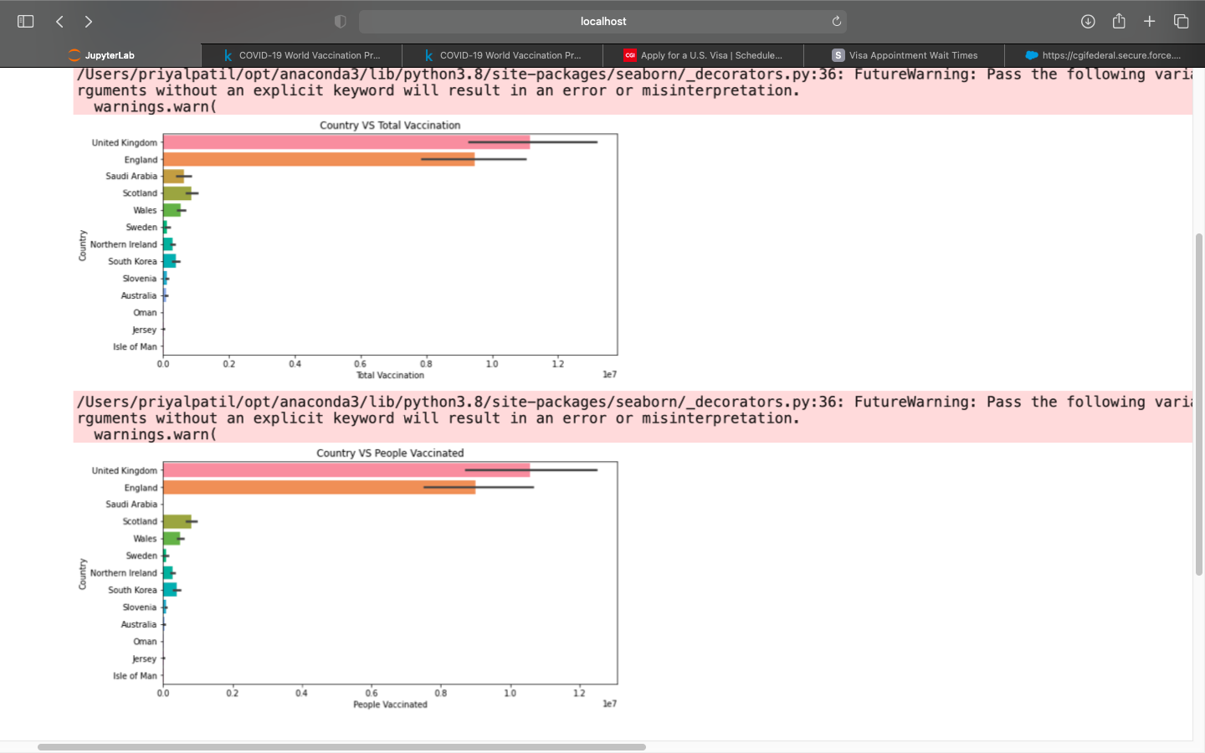
Country vs Total Vaccination :
© All rights reserved by Fireblaze Technologies Pvt. Ltd.

Slide 49
Country vs People vaccinated :
© All rights reserved by Fireblaze Technologies Pvt. Ltd.

Slide 50
Oxford/AstraZeneca, Pfizer/BioNTech, Sinopharm/Beijing, Sputnik V
© All rights reserved by Fireblaze Technologies Pvt. Ltd.

Slide 51
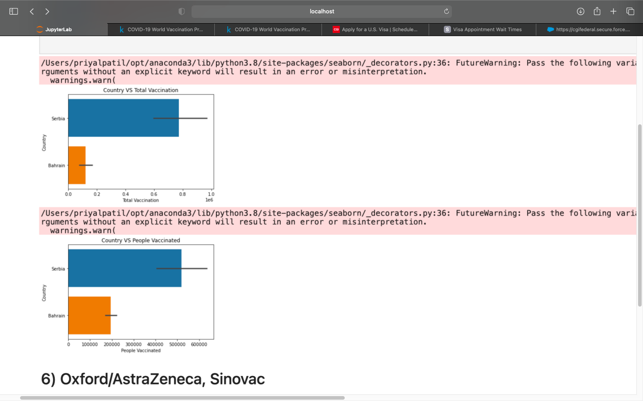
Country vs Total Vaccination :
© All rights reserved by Fireblaze Technologies Pvt. Ltd.

Slide 52
Country vs People vaccinated :
© All rights reserved by Fireblaze Technologies Pvt. Ltd.

Slide 53
Oxford/AstraZeneca, Sinovac
© All rights reserved by Fireblaze Technologies Pvt. Ltd.

Slide 54
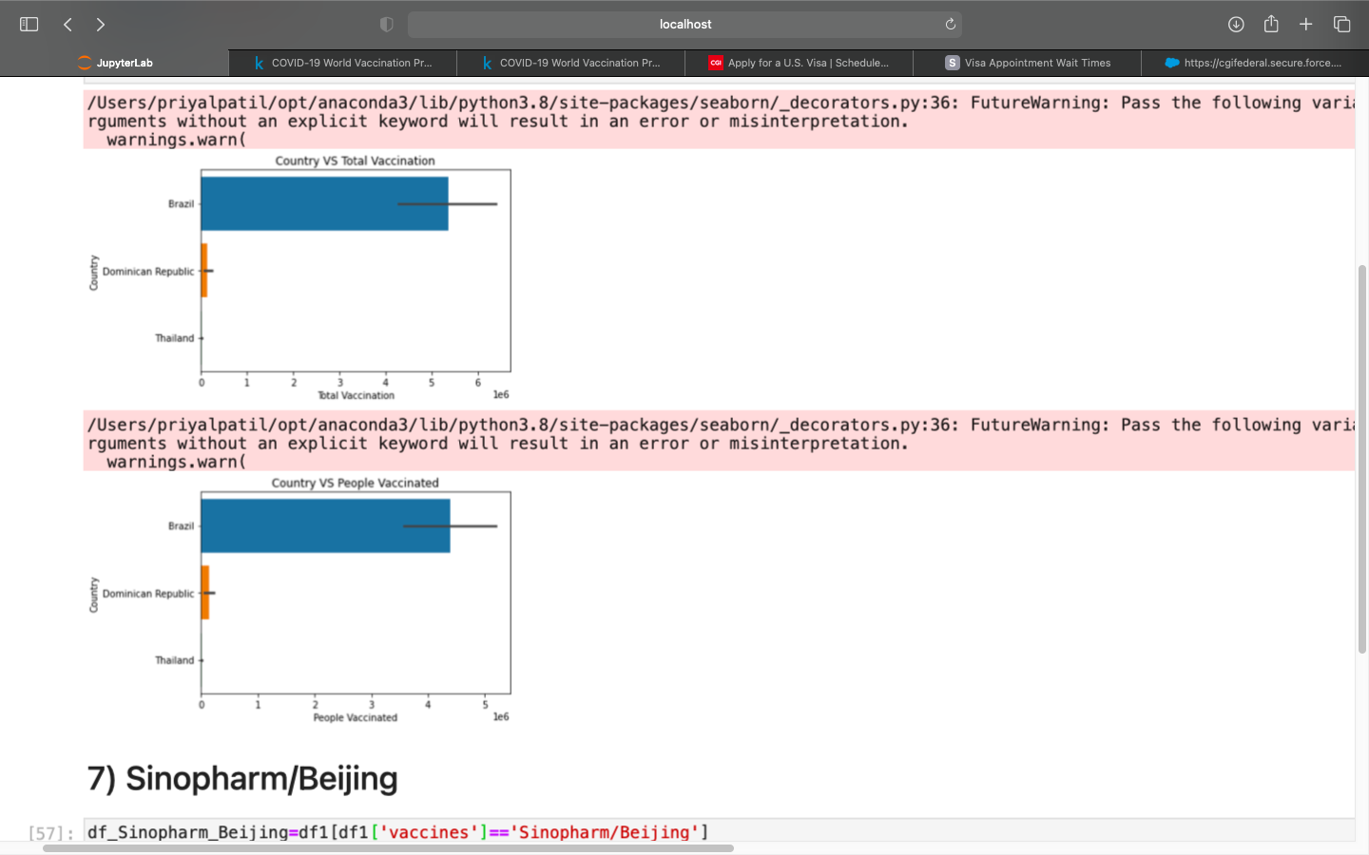
Country vs Total Vaccination :
© All rights reserved by Fireblaze Technologies Pvt. Ltd.

Slide 55
Country vs People vaccinated :
© All rights reserved by Fireblaze Technologies Pvt. Ltd.

Slide 56
Conclusion:
After analyzing the data we can :
Clearly find out which country is using what vaccine or combination of vaccines
Find out in which country the vaccinations per day is highest.
Find out what percent of people are vaccinated out of total population.
Track the progress of COVID - 19 vaccination.
© All rights reserved by Fireblaze Technologies Pvt. Ltd.

